Slide 1

MARRIOTT INTERNATIONAL’S STRATEGIC CYBERSECURITY PLAN
Christopher Phan
Shaquilla Chambers
Zach Zerger
Dr. Branden Williams
Strategic Cybersecurity Practicum CYBS - 8396
Summer 2023
Notes:
Hello, my name is Christopher Phan, and my associates are Shaquilla Chambers and Zach Zerger. We are here to discuss our future plans and implementation of our cybersecurity program for Marriott International.

Slide 2
AGENDA
Review of Part One of the Cybersecurity Plan
Security & Resource Staffing Strategy
Business Continuity Strategy
Incident Response Plan
Marriott International’s Budget
Security Awareness and Education Program
Security Metrics
Overall Cybersecurity Strategy
References
Notes:
Here is the agenda in what we are planning to discuss throughout this presentation so you may see the second part of our cybersecurity plan for Marriott International. The purpose of this will be delving into the concepts that we discussed in part one and creating practical and realistic solutions, demonstrating how these solutions were developed and defend Marriott’s digital assets from now to the future.
Firstly, we will begin with a review from part one from our previous presentation to the board.
Second topic will concern our security and staffing strategy, exploring how Marriott International will gain and retain key staff and talent.
Third part will be our business continuity strategy, examining how Marriott International will continue even if critical systems are failing.
This will transition into our fourth part, our incident response protocols. Focusing on how Marriott International will counter any security events that may appear in the future.
Next is the budget for the cybersecurity operations here at Marriott International.
The sixth point will be one of the most vital operations, that being the security awareness and education on cybersecurity, which our plans in how to develop a security culture and increasing our security posture through our employees.
Our seventh point will be security metrics, which will discuss how our security indicators will be measured and evaluated.
Lastly, is the overall cybersecurity strategy, concluding our future plans.

Slide 3
PART ONE REVIEW
Key Points from Our Part One Cybersecurity Strategy
Marriott International business and cybersecurity mission and core values
Organization of our security teams and their justification
The security challenges that Marriott is experiencing
How These Points are Significant
Establish a set of expectations
Insight to our staffing strategy
How these challenges will be addressed
Notes:
It is important to remind ourselves what our mission and core values are. For Marriott International, our mission is to create an environment for customers that is memorable and pleasant for any occasion, to be the best travel company in the world. Our core values are to put people first, pursue the highest standards of excellence, innovation in the field, and to never compromise our integrity.
For Marriott security teams, our mission is to safeguard information assets from any threats, internal or external, promoting information security. As well, the security core values are the three tenets of all cybersecurity professionals: confidentiality, integrity, and availability.
We also created our IT organization chart, detailing how staff will be oriented, lending these teams to emphasize information security.
Lastly, the security challenges that Marriott International are facing are: data security, insider threat, third party vendor compromise, and regulation upkeep. These are the current challenges that we have decided are most important for Marriott to address.

Slide 4
SECURITY STAFFING STRATEGY
How We Will Acquire New Staff
Online Job Boards
Internal References
Career Fairs
Skills We Are Looking For
Eagerness to adapt
Problem-solving with attention to detail
Can communicate and synergize
Interview and Onboarding
Four rounds of interviews for each new hire
Onboarding will consist of a two week regimen with a month checkup
Attracting and Retaining Staff
Variety of desirable benefits
These benefits will create an effective and flexible environment for our security teams
Handling of staff departure
Notes:
The vectors in how we will reach possible new employees is through: (1) utilizing online job boards as well as using Marriott International career link in our website (2) gaining direct references from security personnel, a pipeline in talent acquisition, and (3) touring universities or events by being at career fairs on rising professionals. As well, Marriott can make use of targeted ads for outreach.
The skills we are looking for new hires in Marriott International are: an eagerness to learn and adapt, advanced problem solving skills with an aptitude for attention to detail, able to effectively communicate and work independently and in a team, and has a greater understanding in cybersecurity core values, application principles, and methodologies.
There will be four rounds of interviews for every new hire: (1) the first round will consist of a HR interview between the candidate to see if they are a culture match, (2) the second round will be the candidate with their perspective security manager, (3) will be a technical interview to test the candidate’s technical skills and their problem solving pace and ability, and (4) the last round of interviews will be the candidate interacting with upper management, looking into their main aspirations for Marriott. Onboarding will consist of a two week training period, where the security team will be supervising and tutoring the candidate until they are ready to work independently.
How we will attract top talent and retain this talent is through a myriad of benefits, include but not limited to: high competitive pay, free insurance, work remotely, annual increase in compensation rate and yearly bonuses, 401K matching, stipend for remote work including wifi, phone, desks, and unlimited PTO. Also this includes Marriott helping to pay for employee’s education, paying for certifications, sponsoring employees to go to conferences, and Marriott will give licenses to employees for learning applications so employees can improve their own skills in their own time. These benefits are highly desirable and would be highly sought after for rising and top talent in the industry.
How we will handle employees leaving Marriott International, there will be an exit interview asking how we can improve our security posture, Marriott International in general, and what we can do to retain staff. It will be advised, but not required, to have a month notice ahead of time so Marriott can prepare for a role gap within our security organization. We will begin advertising on job boards and asking staff if they have any references or preferred replacements for the role. As well, possible internal hiring if there are those interested in the role. If possible, we would like this new personnel to train under the employee that is departing, so they have a direct comparison in what is expected of them. That is the security staffing strategy that Marriott International will operate at. I will be passing this on to Zach Zerger for our business continuity strategy.

Slide 5
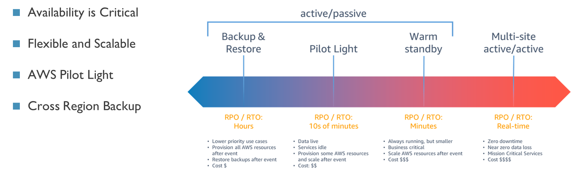
BUSINESS CONTINUITY STRATEGY
Note: From Disaster recovery options in the cloud - Disaster Recovery of Workloads on AWS: Recovery in the Cloud. (2023)
Notes:
Availability is critical for Marriott as it relies on its network to book and manage the occupancy of over 8,000 hotels. The company could lose thousands of potential reservations every hour the network is down. Marriott’s global presence means the network must always run well because it processes and captures data at all hours. Marriott needs contingency systems that are flexible and scalable. Amazon Web Services offers this flexibility with its Pilot Light recovery cloud option. Pilot Light provides data backup solutions as well as duplication of key systems. The option is economically efficient because it only needs to be scaled during a significant disruption occurs. It also offers duplicate storage across regions.
“Thank you Chris
Marriott needs a comprehensive business continuity strategy.
Availability is critical for Marriott as it relies on its network to book and manage the occupancy of over 8,000 hotels. The company could lose thousands of potential reservations every hour if the network is down. Marriott needs a continuity strategy that allows for flexibility and scalability. Amazon Web Services offers this flexibility and scalability with its Pilot Light recovery cloud option. Pilot Light provides data backup solutions as well as duplication of key systems and applications. The option is economically efficient because it only needs to be scaled when a significant disruption occurs. As an Infrastructure-as a-service option, it can spin up instances that can take over when the main network or specific applications fail. It also offers duplicate storage across regions in case of a disaster in one area. Cloud based backup infrastructure gives the company many options and if simulation tests or lessons learned show that shorter recovery metrics are needed, it can always adjust its spending in this area and move to a warm standby or an always active real-time recovery.
A well developed business continuity strategy is essential in today’s threat environment.”

Slide 6
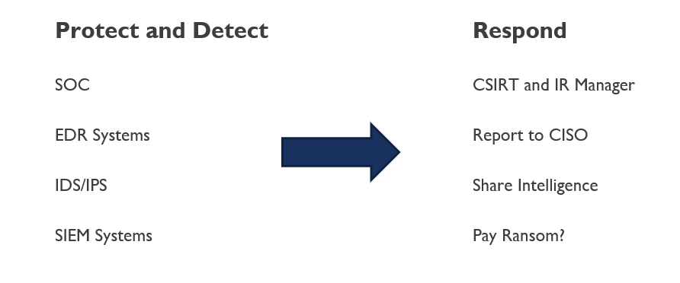
INCIDENT RESPONSE PLAN
Notes:
Before there can be a response to an incident, there needs to be good detection infrastructure in place. The infrastructure would include having a Security Operations Center that monitors the network and reacts to alerts. Security and Event Management Systems can help track and automate the process. The network needs endpoint detection systems and IDS/IPS systems placed throughout the network. The incident response plan includes setting up a Computer Security Incident Response Team CSIRT, which the Incident Response Manager would lead. Incidents would be reported to the CISO and other compliance personnel, depending on the incident. The company would share intelligence with groups like CISA and local authorities. In a ransomware attack, the company would consider paying a ransom if it is determined that sensitive data was extracted in cleartext to try and prevent the data from being released. If no data was exfiltrated, the company would not pay the ransom and move to restore its data and systems from cloud backup.
“Before there can be a response to an incident, lots of preparation must be done. Policies and procedures must be put in place. There needs to be designated personnel with an alert roster as well as out of band communications set up so the team can communicate off the network if needed. There needs to be good detection infrastructure in place. The infrastructure includes having a Security Operations Center that monitors the network and reacts to alerts. The SOC will utilize Security Information and Event Management Systems along with Security Orchestration, automation, and Response technology to help track and automate the process. The network needs endpoint detection systems and IDS/IPS systems placed throughout the network so it can feed logs into the SIEM. Analysts or the SOAR can pick up on Indicators of Compromise from these logs and determine if an incident has occurred. The incident response plan includes setting up a Computer Security Incident Response Team CSIRT, led by an Incident Response Manager. Incidents would be reported to the CISO, Legal, compliance personnel, HR and Public Relations depending on the incident. The company would share intelligence with groups like CISA and local authorities. In a ransomware attack, the company would consider paying a ransom if it is determined that sensitive data was extracted in cleartext to try and prevent the data from being released. If no data was exfiltrated, the company would not pay the ransom and move to restore its data and systems from cloud backup.
Following an incident, the plan would include details to Contain, Eradicate and Recover as well as Post Incident activities. These activities include sharing lessons learned among all participants and leadership.“

Slide 7
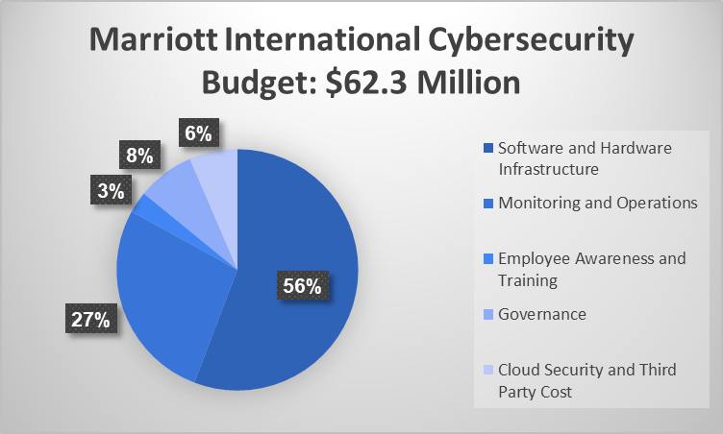
BUDGET
Notes:
Marriott’s budget is in line with others in the industry with a $62 million budget, which is .3 percent of annual revenue, based on a Deloitte study (Deloitte, 2020). The current budget has a significant allocation for Software and Hardware infrastructure as the company focuses on building out a more secure integrated network with endpoint security, identity management solutions, and application and data security as areas of focus.
“Marriott’s budget should be in line with others large corporations with a $62 million budget, which is .3 percent of annual revenue. The current budget has a significant allocation for Software and Hardware infrastructure as the company focuses on building out a more secure integrated network with endpoint security solutions, identity management solutions, and application and data security as areas of focus.
With that I will hand it over to Shaquilla to go over security awareness and education.”.”

Slide 8
SECURITY AWARENESS AND EDUCATION
The Security Awareness and Education Program includes a Learning Management System (LMS) that develops interactive training modules on various cybersecurity topics. Accessible to all employees, the platform houses comprehensive documents outlining our cybersecurity policies and procedures. Our team promptly disseminates security alerts and updates, keeping employees informed about emerging threats and best practices.
Notes:
Today, I will discuss Marriott's Security Awareness and Education platform, which was designed to foster a culture of cybersecurity consciousness. Recognizing that cybersecurity is a collective responsibility, our initiative is strategically devised to mitigate cyber risks across the organization. Our approach incorporates several essential components. We've implemented various elements like interactive training modules, a system for disseminating security alerts, and a dedicated button to report phishing incidents. We also run simulated phishing campaigns and have an employee recognition program to reward strong cybersecurity practices.
We use engaging multimedia elements, workshops, webinars, newsletters, and visual aids to communicate. Our key topics include password security, phishing awareness, data protection, mobile device security, safe internet browsing, ransomware awareness, and the importance of using a VPN.
Our training occurs before system access and is repeated periodically. We also maintain continuous security awareness through regular communication. To measure our plan's impact, we assess employees' understanding of cybersecurity before and after training, analyze phishing simulations, track security incidents, and collect employee feedback. We believe in catering to different learning styles for effective comprehension.

Slide 9
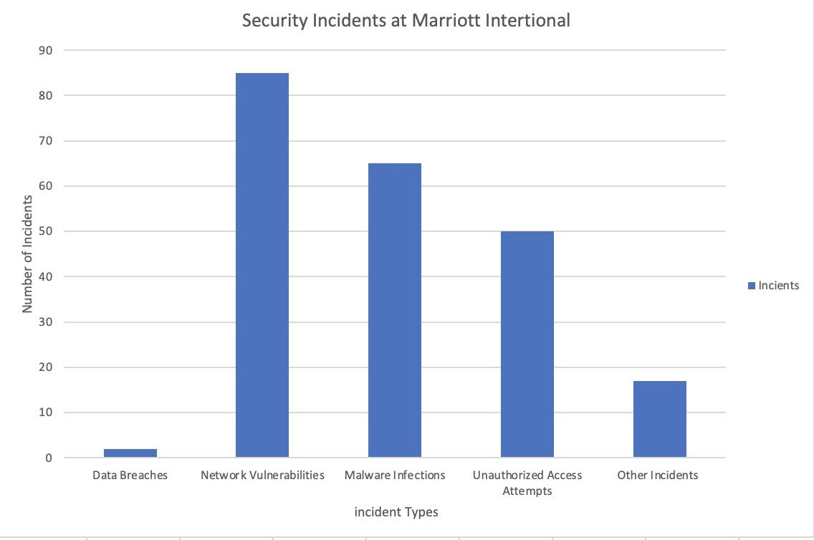
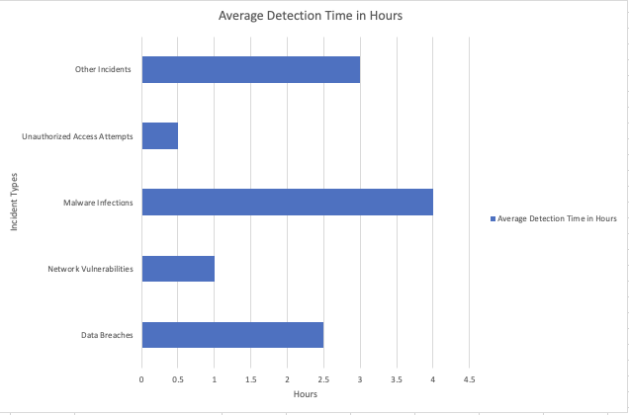
SECURITY METRICS
Notes:
Now let’s discuss the cybersecurity enhancements that have been implemented at Marriott International, particularly in the aftermath of the significant data breach in 2018. As a response to this incident, we have introduced robust security metrics that play a crucial role in both maintaining and evaluating our overall security posture.
One of the key security metrics we employ is the 'Number of Security Incidents.'This metric provides us with a quantitative measure of the security posture by tracking the total count of breaches, incidents, or vulnerabilities within the organization's infrastructure. By analyzing this data, we can identify trends and potential areas of weakness in our security system, enabling us to take proactive measures to address them. Our SOC team takes responsibility for collecting, analyzing, and reporting security incidents on a real-time or near real-time basis. Additionally, monthly or quarterly reports are generated to provide a comprehensive overview of incidents and trends.
In addition the SOC monitors the other metric the 'Mean Time to Detect,' commonly referred to as MTTD. This metric signifies the average duration it takes to identify a security incident from the moment it originates. By measuring MTTD, we gain insights into the effectiveness of our security monitoring and detection systems, enabling us to streamline our response times.

Slide 10
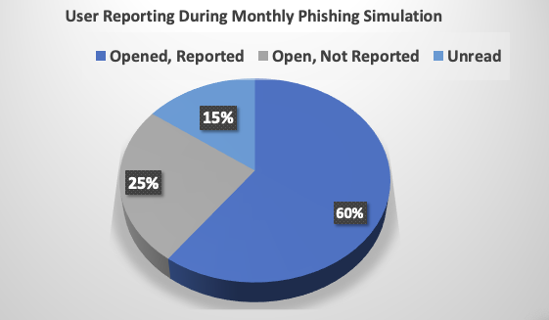
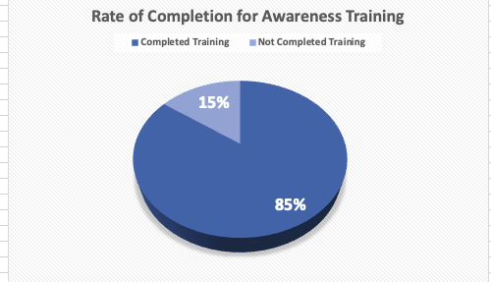
SECURITY METRICS
Notes:
"Moving on to the third metric which is the 'Rate of User Engagement for Phishing Simulation.' This measures how many users interact with simulated phishing attempts. This metric gauges the effectiveness of our security awareness training and points to areas needing more attention and reinforcement. By quantifying user engagement, we gauge the efficiency of our security awareness training initiatives and pinpoint areas that require more attention and reinforcement. Also, this metric enables us to measure the success of our security awareness training programs and offers insights into our susceptibility to phishing attempts.
Additionally, we track the ‘Completion Rate for Security Awareness Training’. This metric tracks the number of employees who have completed the required security awareness training. By monitoring the completion rate, we can assess the level of employee engagement and understanding of security best practices. These visual aids of our security metrics assist us in comprehending our security protocols and strategies more effectively. By concentrating on these metrics, we are well-equipped to reinforce our defenses and adeptly protect against evolving security threats.

Slide 11
CYBERSECURITY STRATEGY
Emphasize a multi-faceted approach to cybersecurity to tackle diverse threats from an evolving landscape, human error, and system interconnectivity.
Key focus areas for reinforcing the cybersecurity strategy:
Prioritizing cybersecurity, investing in employee training, establishing security metrics, optimizing resource strategy, and fostering a culture of security.
Regular monitoring, collaboration, and a business continuity plan are pivotal for maintaining a resilient cybersecurity posture.
Leadership should prioritize cybersecurity by implementing robust security measures, allocating sufficient funding and resources, and investing in cybersecurity awareness training for well-educated employees.
Notes:
As Marriott International's Chief Information Security Officer, I emphasize the importance of a multi-faceted approach to cybersecurity. This involves tackling evolving threats, human error, and system interconnectivity. To reinforce our strategy, we must prioritize cybersecurity, invest in employee training, establish security metrics, optimize resource strategy, and foster a culture of security. Regular monitoring, collaboration, and a business continuity plan are pivotal for a resilient cybersecurity posture. Leadership should prioritize cybersecurity by implementing robust security measures, allocating sufficient funding and resources, and investing in cybersecurity awareness training. By defining metrics and implementing an effective incident response plan, we can assess success and minimize cyber incidents.
So, join us in building a safer digital future! Take action now by advocating for cybersecurity awareness, supporting employee training, and championing resource allocation. Let's work together to strengthen our defenses, measure our progress, and ensure a resilient cyber landscape for Marriott International.
The next slide is our references and that conclude the presentation for today.

Slide 12
REFERENCES
Deloitte Center for Financial Services. (2020). Reshaping the Cybersecurity Landscape. www.deloitte.com. https://www2.deloitte.com/content/dam/insights/us/articles/6507_Cybersecurity-FS-ISAC/DI_2020-FS-ISAC-Cybersecurity.pdf
Disaster recovery options in the cloud - Disaster Recovery of Workloads on AWS: Recovery in the Cloud. (2023). www.aws.amazon.com. https://docs.aws.amazon.com/whitepapers/latest/disaster-recovery-workloads-on-aws/disaster-recovery-options-in-the-cloud.html

